Slide 1
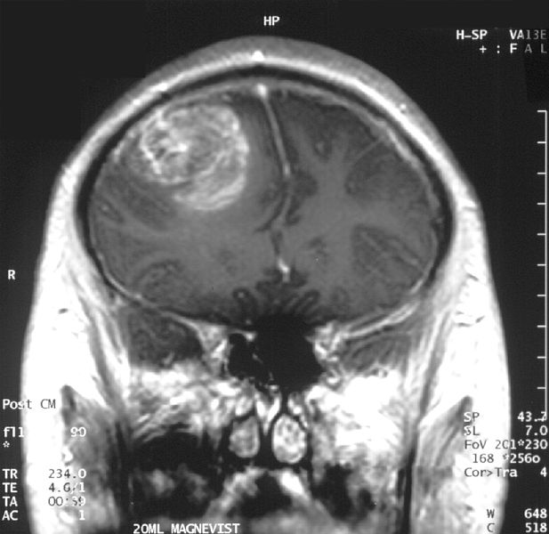
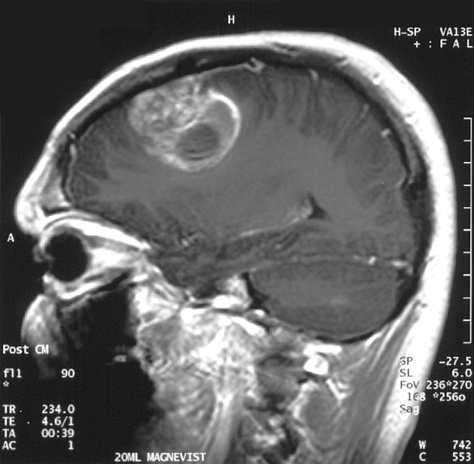
Comprehensive genomic characterization defines human glioblastoma genes and core pathways
By: Katie Adolphsen, Robin Aldrich, Brandon Hu,
Nate Havko

Slide 2
The Cancer Genome Atlas: TCGA
Collaborative effort
$100 million pilot project
Funded by National Cancer Institute and the National Human Genome Research Institute of the National Institutes of Health

Slide 3
Goals
Standardization of biospecimen collection
Publication of large amount of data in an expedient time frame

Slide 4
Pilot Project
First looked:
  squamous carcinoma
  serous cystadenocarcinoma
  glioblastoma
DNA copy number
Gene expression
DNA methylation aberrations
Nucleotide sequence aberrations

Slide 5
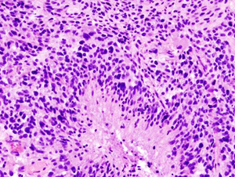
Glioblastoma
Most common type of brain cancer
  52% of parenchymal brain tumor cases
  20% of intracranial tumors
Glioblastoma multiforme (GBM) is most aggressive type of primary brain tumor
Involves glial cells

Slide 6
Biospecimen Collection
Newly diagnosed glioblastoma
Matched normal tissues
Associated demographic, clinical and pathological data

Slide 7
Quality Control
Reviewed by Biospecimen Core Resource
Minimum 80% tumor nuclei
Maximum 50% necrosis
Screened for qualification of techniques
206 of the 587 biospecimens screened were qualified

Slide 8
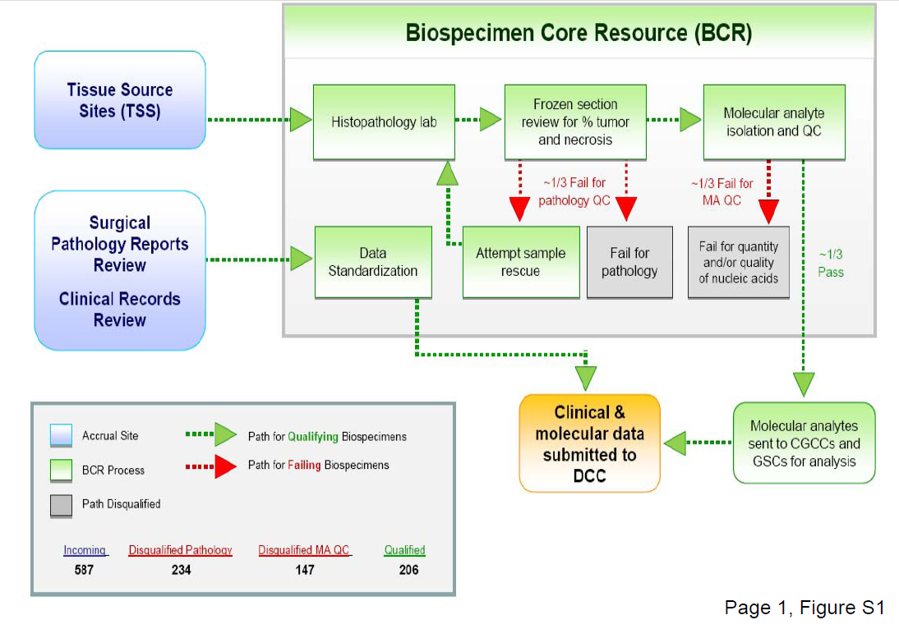

Slide 9
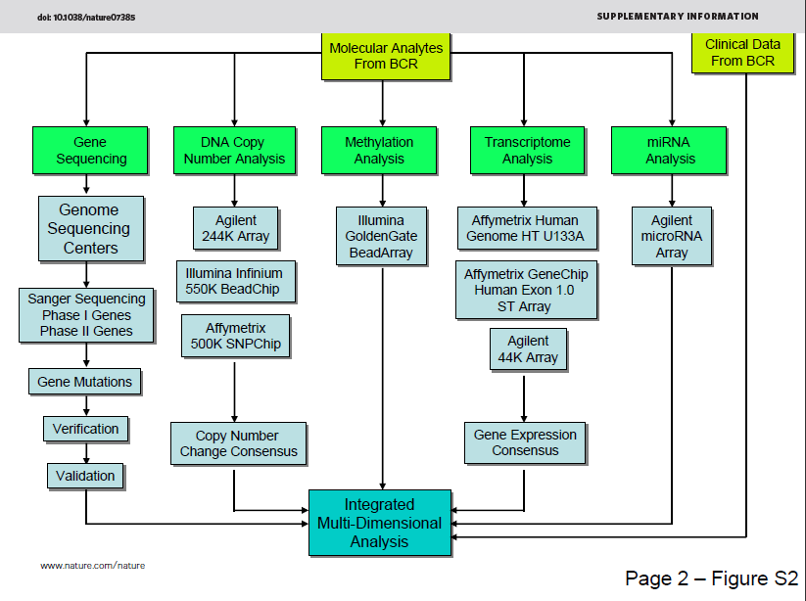
Methods

Slide 10
Copy Number Alteration
Microarray platform
Analytical logarithm
Significant copy number alterations
Correlation of copy number

Slide 11
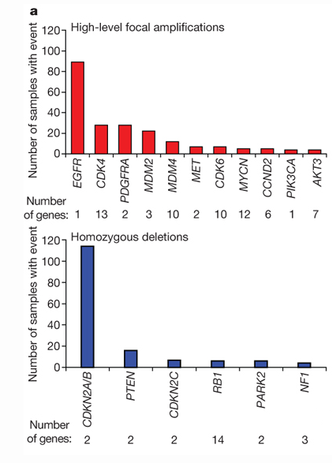
Genomic and Transcriptional Aberrations
Figure 1

Slide 12
Nucleotide Alterations
91 matched tumor-normal pairs
  72 untreated
  19 treated
601 sequences
  453 validated non-silent somatic mutation
  223 unique genes

Slide 13
Treated vs Untreated
Background mutation rates
  1.4 in untreated
  5.8 in treated
    Caused by temozolomide treatment
TP53
  DNA binding domain mutations
Hypermutated Phenotype
  Prompted MMR investigation
  MLH1, MSH2, MSH6, PMS2

Slide 14
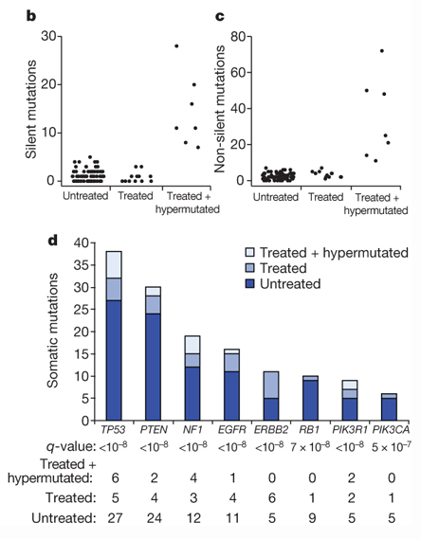
Patterns of Somatic Nucleotide Alternations in Glioblastoma
Figure 1

Slide 15
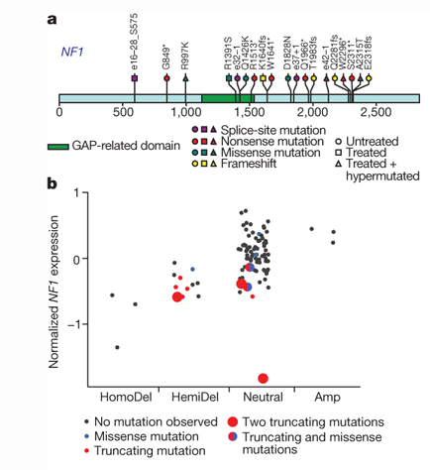
NF1
Neurofibromin 1
Glioblastoma suppressor gene
47 of 206 inactivating mutations

Slide 16
NF1
Correlation between gene copy number and gene expression
Figure 2

Slide 17
EGFR
Epithelia growth factor receptor
Variant III domain mutations
  Extracellular domain
  41 of 91 sequenced samples had some alteration

Slide 18
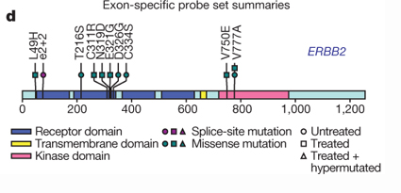
Related Growth Factor Mutations

Slide 19
PI(3)K complex
  Phosphoinositide 3-kinase is involved in cellular functions
    cell growth, proliferation, differentiation, motility, survival and intracellular trafficking
  Catalytically active protein: p110α
Regulatory protein: p85α
Mutations disrupt interactions
  Missense
  Deletions
  Nucleotide substitution

Slide 20
PI(3)K
PIK3CA
  6 detected in 91 samples
  4 known
  2 novel in-frame
PIK3R1
  9 mutations of 91 samples
  8 within SH2 domains
  4 were 3-bp in-frame deletions
Novel point mutations relieve the inhibitory effect of p85α on p110α

Slide 21
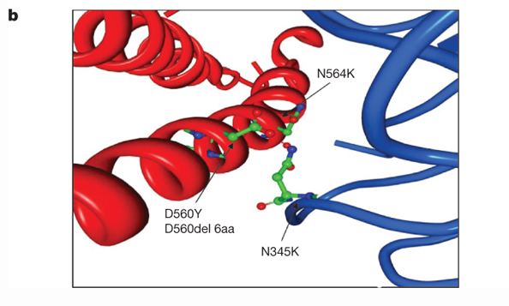
PI(3)K
p110α
p85α
Spatial constraints cause constant PI(3)K activation

Slide 22
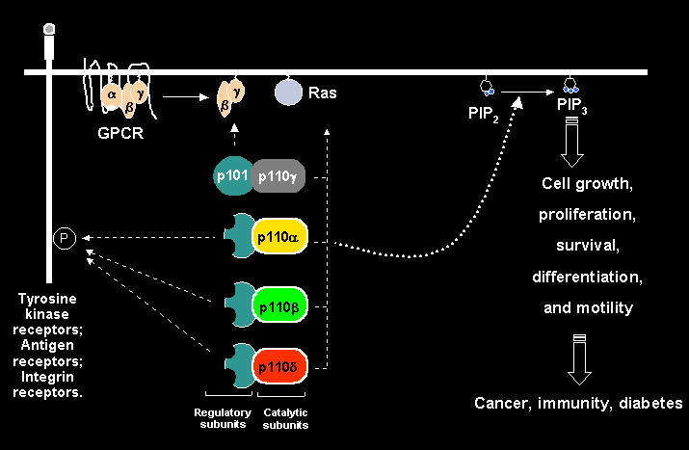

Slide 23
MGMT
Methylation transferase activity
Assay for promotor methylation
Methylated MGMT promotor associated with hypermutator phenotype

Slide 24
MGMT
Relationship with hypermutator phenotype
Clinical implications
  Methylation state changes response to alkylating reagents
C•G A•T

Slide 25
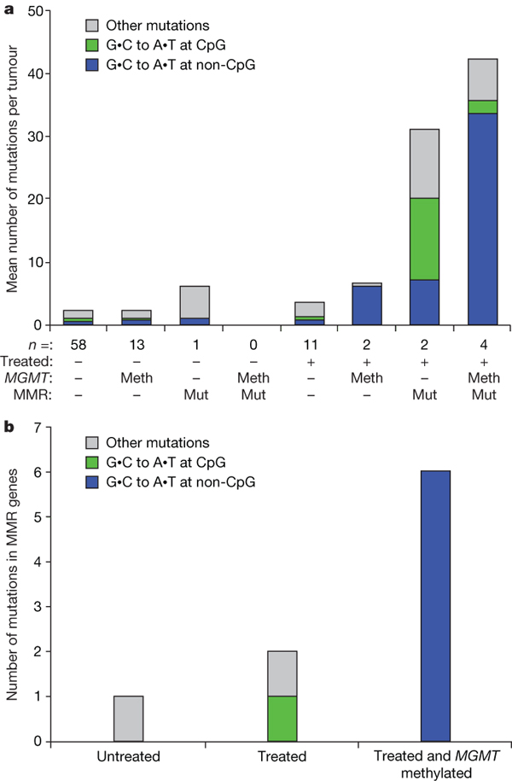
Figure 4

Slide 26
Integrative analyses define glioblastoma core pathways
Mapped the alterations
  Somatic nucleotide substitutions
  Homozygous deletions
  Focal amplifications
Analysis found major interconnected network of aberrations
3 major pathways found
  RTK signaling
  P53 suppressor pathway
  RB tumor suppressor pathway

Slide 27
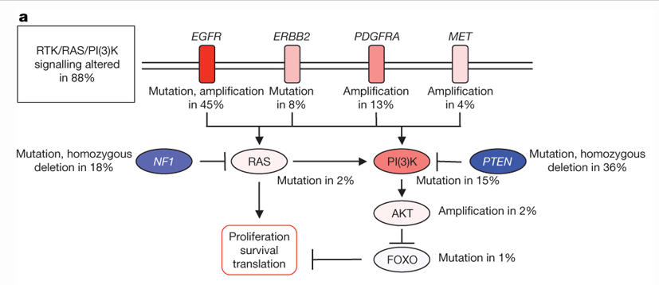
RTK/RAS/PI(3)K Signaling
Red = activating genetic alterations
Blue = inactivating genetic alterations

Slide 28
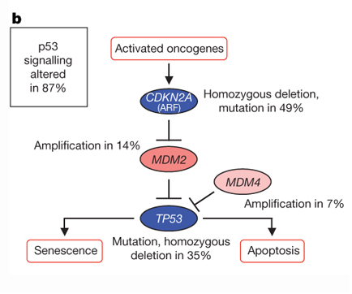
P53 Signaling
Red = activating genetic alterations
Blue = inactivating genetic alterations

Slide 29
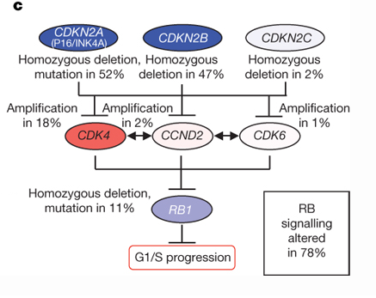
RB Signaling
Red = activating genetic alterations
Blue = inactivating genetic alterations

Slide 30
Big picture
TCGA
  Powerful multi-dimensional data
  Integrative analysis
  New discoveries
  Unbiased and systematic analysis
  Ultimate discoveries

Slide 31
Questions?

